Slide 1
The Object Detection Dataset
Eng Teong Cheah

Slide 2
Objective
The data reading for object detection is similar to that for image classification. However, after we introduce bounding boxes, the label shape and image augmentation (e.g., random cropping) are changed.

Slide 3
Contents
The Object Detection Dataset

Slide 4
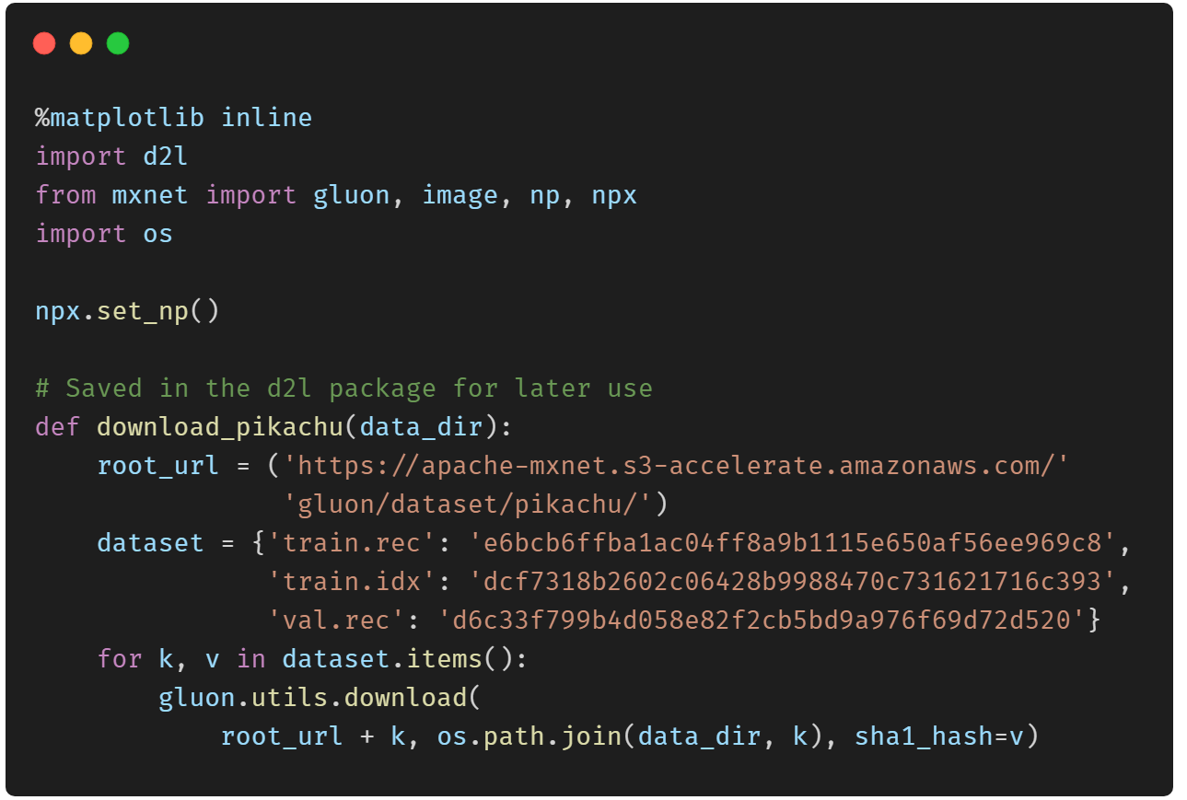
Downloading the Dataset

Slide 5
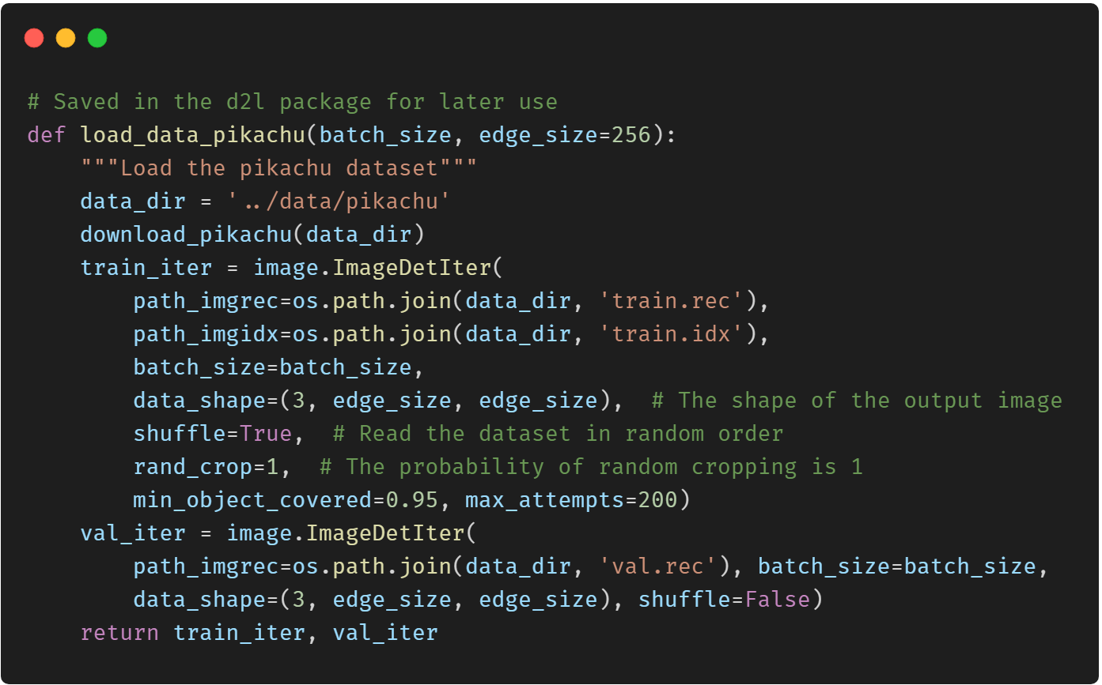
Reading the Dataset

Slide 6
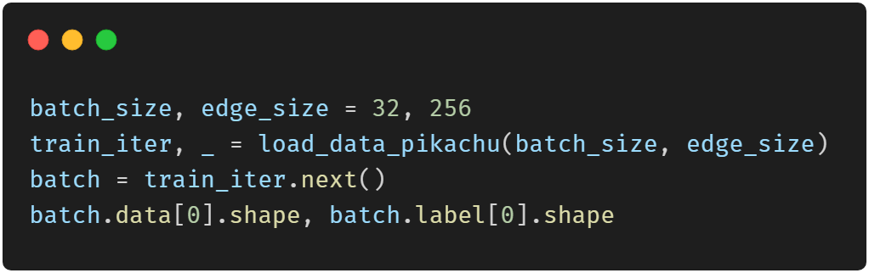
Reading the Dataset

Slide 7
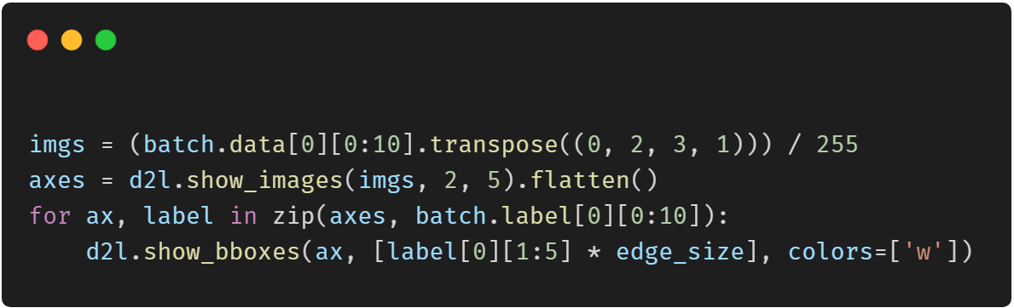
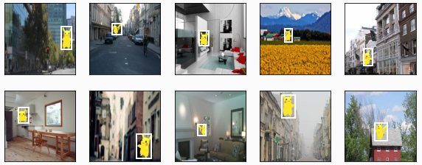
Demonstration

Slide 8
Thank You！
Does anyone have any questions?
Twitter: @walkercet
Blog: https://ceteongvanness.wordpress.com

Slide 9
Resources
Dive into Deep Learning

